Slide 1
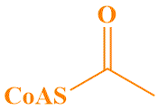
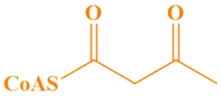

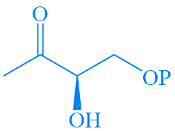
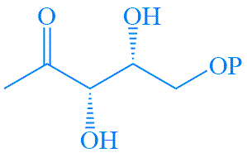
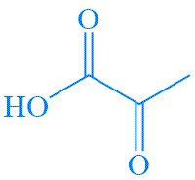


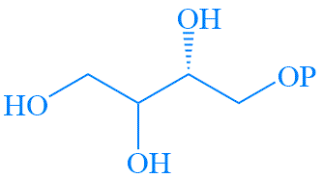
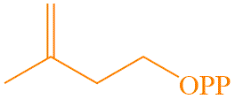
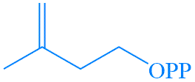


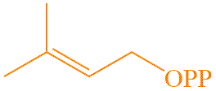
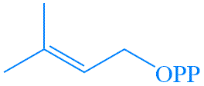

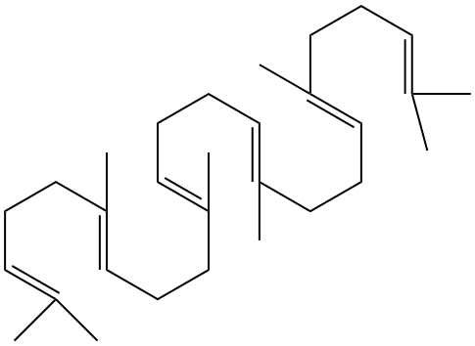
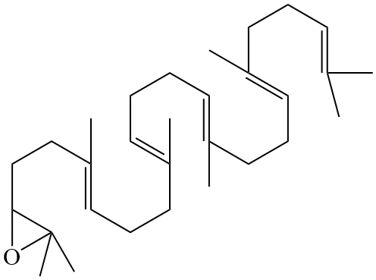
Fig. S1.
MVA Pathway
MEP Pathway
AACT
HMGS
G3P
A-CoA
AA-CoA
HMG-CoA
DXS
HMGR
DXP
MVK
pyruvate
MVP
MVA
DXR
Cytosol
MCT
pyruvate
MEP
MDS
CMK
PMK
HDS
MVD
HDR
IPP
IPP
MVPP
IDI
HMBPP
HDR
FPPS
FPPS
DMAPP
Peroxisome
DMAPP
Plastids
FPP
SS
squalene
SE
Endoplasmic Reticulum
2,3-oxidosqualene

